Slide 1
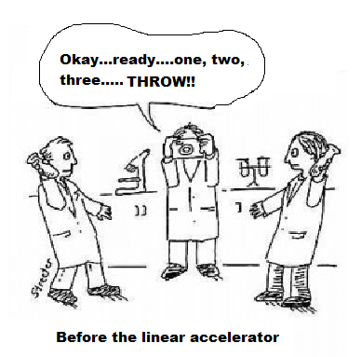
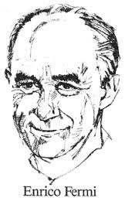
Welcome to Grade12 Physics!

Slide 2
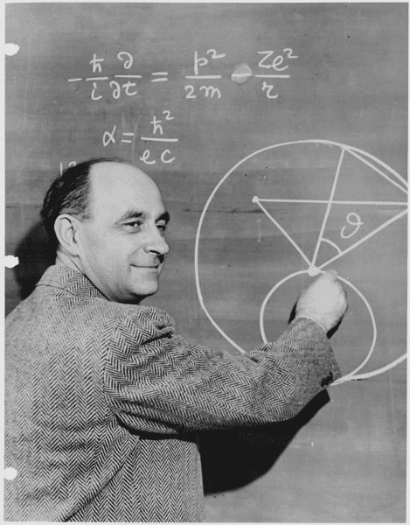
Fermi Question Challenge
Italian-born physicist Enrico Fermi was legendary for being able to solve problems that were not well defined!
He would estimate unknown quantities and then proceed to develop a logical solution using these estimates.
His goal was to find a reasonable
“order of magnitude” answer.
The process was more important than
the actual answer!!

Slide 3
1. How many water balloons could fill this room?
2. How many jelly beans could fill a 1 Litre jar?
3. How many dentists are there in Brampton?
4. How many steps would it take you to walk around the Earth?

Slide 4
Measurement Principles Recap
If you cannot measure it, then it is not science. —Lord Kelvin
An experiment is a question which science poses to Nature, and a measurement is the recording of Nature's answer. — Max Planck

Slide 5
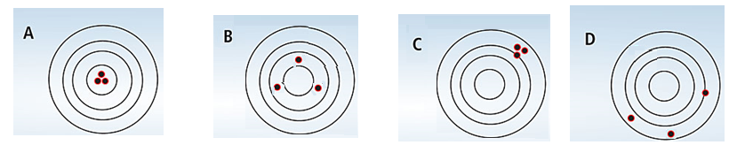
Measurement Accuracy versus Precision
Measurement Error or Uncertainty:
No measurement is exact! All measurements have some inherent error or uncertainty.
Accuracy: refers to how closely measurement agrees with the “true” value
Precision : refers to the resolution with which a measurement is made. For multiple measurements, it can refer to the scatter in the values.
Accurate &
precise
Accurate,
Not precise
Precise but,
Not accurate
Not accurate,
Not precise

Slide 6
Measurement uncertainty and Significant digits
Record all certain digits in a measurement plus last estimated or uncertain digit
Example 1: A length of 10.2 ± 0.1 cm
-state measurement error (uncertainty)
- the uncertainty should match the
measurement precision
Example 2: A mass of 15.05 g ± 0.02 g
All of the digits in these measurements are significant!

Slide 7
Significant Digits:
All digits in a measured number are significant EXCEPT:
●leading zeros for decimal numbers (as they are placeholders)
●trailing zeros for whole numbers (as they are placeholders)
Counted Values are considered EXACT (infinite significant digits)
Examples:
4 sd
16.05 kg : ________________
3 sd
0.0255 s : ________________
2 sd
170 m : ________________
5 sd
60.000 mL : ________________
Infinite! (A count)
30 students: ________________
5 sd
1.0025 g: ________________

Slide 8
Weakest Link Rules:
When multiplying/dividing numbers keep the LOWEST number of Significant Digits
Eg. 2.4 cm x 1.563 cm = 3.7512 cm²
Should be rounded to:
3.8 cm² to 2 sig digs
When adding/subtracting numbers keep the LOWEST number of decimal places
Eg. 1.25 m + 3.865 m + 12 m= 17.115 m
Should be rounded to:
17 m to 0 dp

Slide 9
New Concept: Absolute and Relative Uncertainty
Absolute error is expressed in the units as the measurement
E.g. 16.5 cm ± 0.2 cm
1.265 kg ± 0.0005 kg
Relative or Percent error is expressed as a percentage of the given measurement
E.g. 3.8 kg ± 2.0 %
5.6 m ± 5.0 %

Slide 10
Converting between Absolute and Relative Uncertainty
Convert to relative uncertainty:
8.4 kg ± 0.5 kg
Convert to absolute uncertainty:
12.6 m ± 4%
Answer: 8.4 kg ± 6%
Answer: 12.6 ± .5 m

Slide 11
Propagating Errors
When adding or subtracting numbers we ADD the absolute uncertainties
When multiplying or dividing numbers we ADD the relative uncertainties
Find the absolute uncertainty when these lengths are added:
(1.5 m ± 0.2 m) + (1.36 m ± 0.05 m) + (2.85 m ± 0.08 m)
=
5.71 m ± 0.33 m ≅ 5.7 ± 0.3 m
Find the relative uncertainty when lengths are multiplied to find volume:
(1.5 m ± 0.2 m) x (1.36 m ± 0.05 m) x (2.85 m ± 0.08 m)
=
5.814 m³ ± (0.13% +0.037% + 0.028%)
≅ 5.8 m³ ± 0.2%

